Slide 1

ME23312 ENGINEERING THERMODYNAMICS
Unit III – Properties of Pure Substance · Presentation 8 of 10
Determination of the Dryness Fraction – Steam Calorimeters
Sampling · barrel calorimeter · separating calorimeter · throttling calorimeter · combined separating and throttling calorimeter · comparison
Dr. Anantha Raman L., M.E., Ph.D. · Associate Professor, Department of Mechanical Engineering, Rajalakshmi Institute of Technology, Chennai

Slide 2

In this presentation
Why a calorimeter?
Barrel (bucket) calorimeter
Separating calorimeter
Throttling calorimeter
When the throttling calorimeter works
Combined separating and throttling calorimeter
Comparison of the calorimeters
ME23312 Engineering Thermodynamics · Unit III · Presentation 8
2

Slide 3
Why a calorimeter?
The dryness fraction of steam leaving a boiler or flowing in a pipe cannot be measured directly
A steam calorimeter brings a sample to a state whose properties can be measured and applies the energy balance
The sample is taken through a perforated tube inserted across the pipe so that it is representative of the flow
Instruments: barrel, separating, throttling, combined, electrical
ME23312 Engineering Thermodynamics · Unit III · Presentation 8
3

Slide 4
Barrel calorimeter
1
ME23312 Engineering Thermodynamics · Unit III · Presentation 8
4

Slide 5
Barrel (bucket) calorimeter
m_{s} [h_{f} + x h_{fg} – c_{w} t₂] = (m_{w} + m_{e}) c_{w} (t₂ – t₁)
Wet steam m_{s} condensed in cold water m_{w} (initial t₁) in an insulated barrel; final temperature t₂
Heat lost by the steam = heat gained by the water and the barrel (water equivalent m_{e})
Simple but inaccurate – heat losses and a small temperature rise
ME23312 Engineering Thermodynamics · Unit III · Presentation 8
5

Slide 6
Separating calorimeter
2
ME23312 Engineering Thermodynamics · Unit III · Presentation 8
6

Slide 7
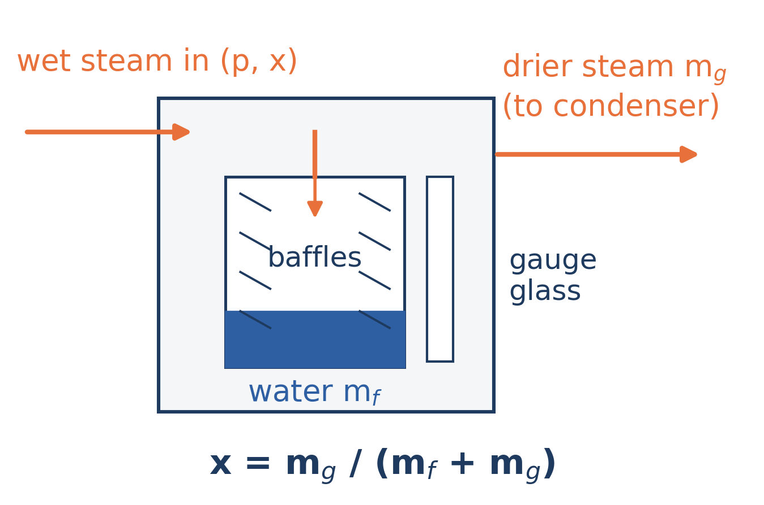
Separating calorimeter
Baffles throw the heavier water droplets out of the stream; the water collects below and the drier steam passes on to be condensed
ME23312 Engineering Thermodynamics · Unit III · Presentation 8
7

Slide 8
Separating calorimeter
x = m_{g}/(m_{f} + m_{g})
Sudden changes of direction throw out the water; its mass m_{f} is read from a gauge glass; the drier steam is condensed and weighed, m_{g}
Separation is never complete – fine moisture is carried over, so it over-estimates x
The only instrument for very wet steam; first stage of the combined calorimeter
ME23312 Engineering Thermodynamics · Unit III · Presentation 8
8

Slide 9
Throttling calorimeter
3
ME23312 Engineering Thermodynamics · Unit III · Presentation 8
9

Slide 10
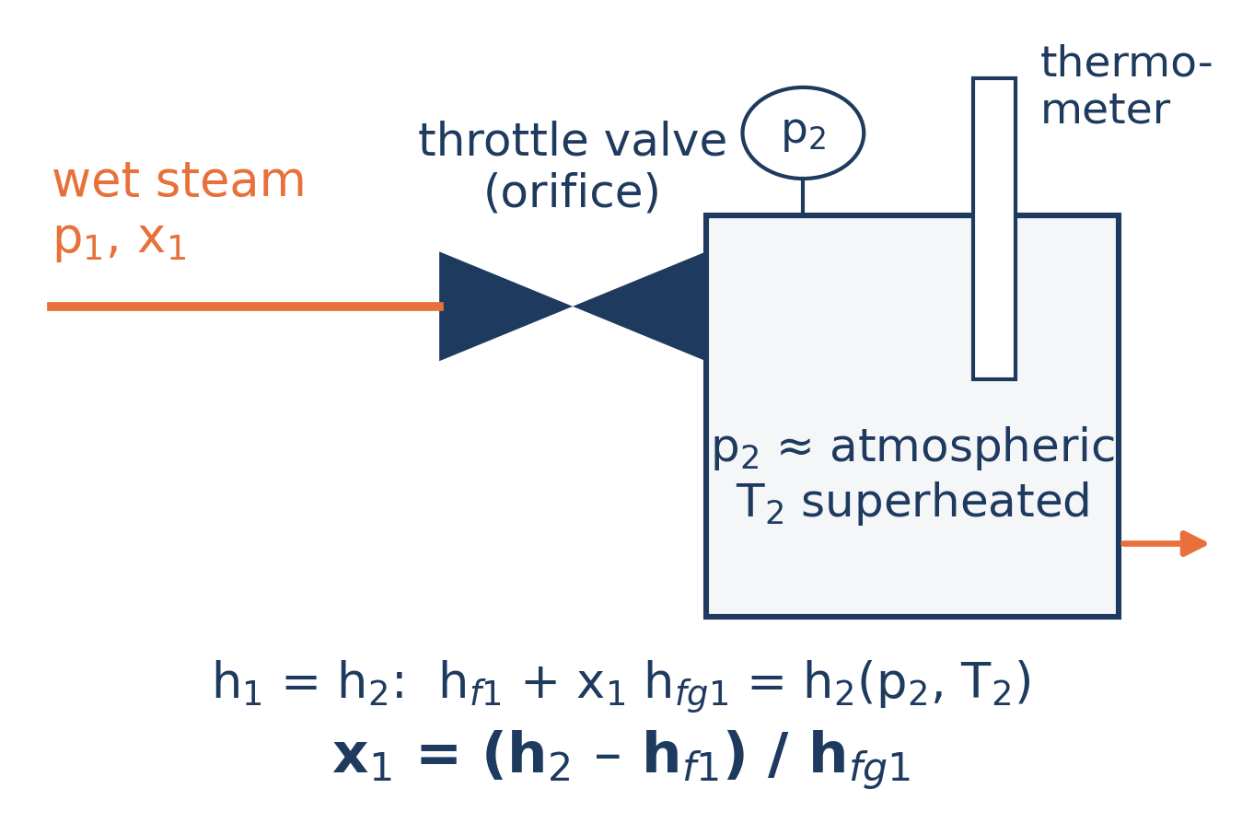
Throttling calorimeter
The sample is throttled from the pipe pressure p₁ to a low pressure p₂; p₂ and T₂ are measured in the insulated chamber
ME23312 Engineering Thermodynamics · Unit III · Presentation 8
10

Slide 11
Throttling calorimeter
h_{f1} + x₁ h_{fg1} = h₂(p₂, T₂) ⇒ x₁ = (h₂ – h_{f1})/h_{fg1}
Throttling is a constant-enthalpy process (Unit I)
If the throttled steam is superheated, its state is fixed by p₂ and T₂ and h₂ is read from the superheat table
On the Mollier chart: a horizontal line from the wet region at p₁ into the superheated region at p₂
ME23312 Engineering Thermodynamics · Unit III · Presentation 8
11

Slide 12
When the throttling calorimeter works
Accurate – but only if the throttled steam is superheated by at least about 5 K
Limits it to fairly dry steam: x above roughly 0.95 for the usual pressure ratios
For wetter steam the two instruments are combined
ME23312 Engineering Thermodynamics · Unit III · Presentation 8
12

Slide 13
Combined separating and throttling calorimeter
4
ME23312 Engineering Thermodynamics · Unit III · Presentation 8
13

Slide 14
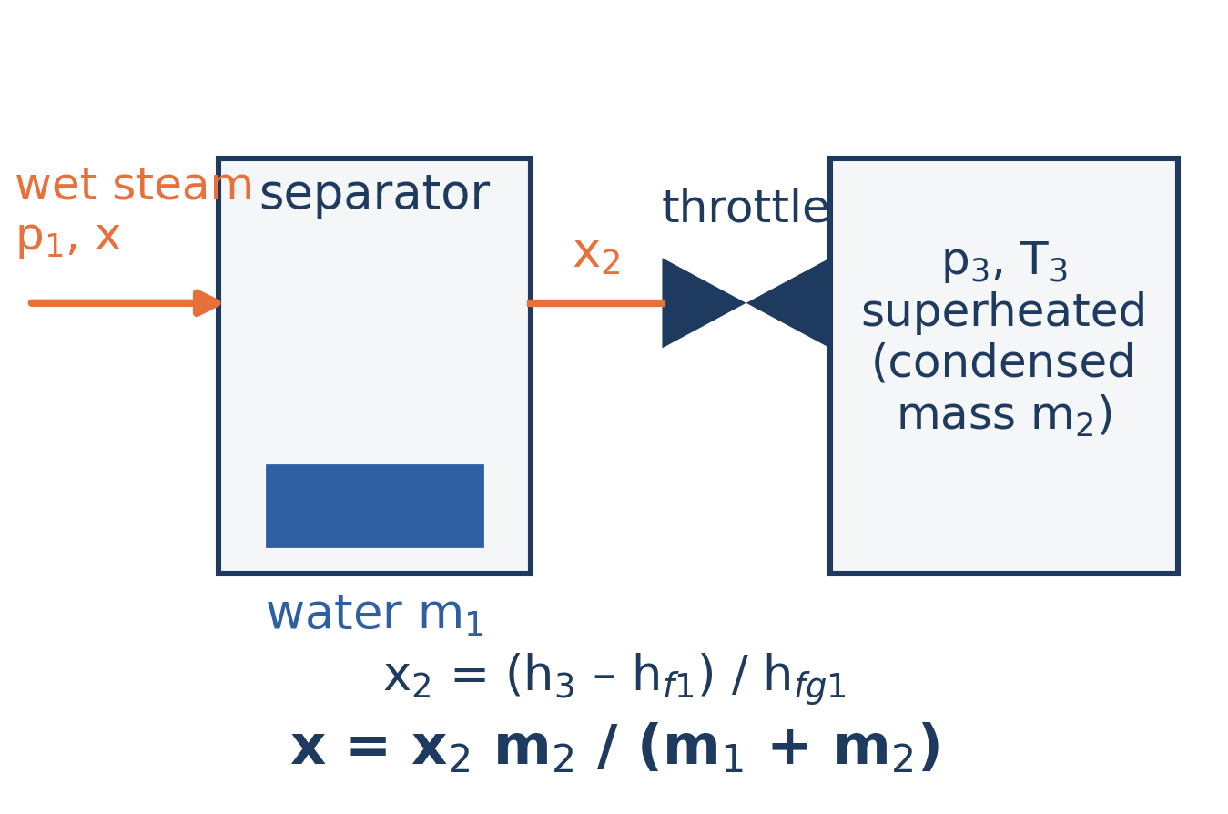
Combined separating and throttling calorimeter
The separator removes most of the moisture; the partially dried steam is then throttled into the superheated region
ME23312 Engineering Thermodynamics · Unit III · Presentation 8
14

Slide 15
Combined calorimeter
x₂ = (h₃ – h_{f1})/h_{fg1} x = x₂ m₂/(m₁ + m₂) = x₁ x₂
Separator collects water m₁; the partially dried steam (x₂, mass m₂) is throttled to p₃, T₃
h_{f1}, h_{fg1} at the pipe pressure p₁ – unchanged through the separator
Dry vapour in the sample = x₂ m₂; total mass = m₁ + m₂; x₁ = m₂/(m₁ + m₂) is the separator reading
ME23312 Engineering Thermodynamics · Unit III · Presentation 8
15

Slide 16
Comparison of the calorimeters
Calorimeter | Principle | Suitable for | Limitation
Barrel | Energy balance with cold water | Rough checks | Inaccurate – heat losses, small ΔT
Separating | Mechanical separation of moisture | Very wet steam | Over-estimates x – carry-over of fine moisture
Throttling | h = constant into the superheated region | Fairly dry steam, x > 0.95 | Throttled steam must be superheated (≥ 5 K)
Combined | Separation, then throttling | Any wetness | Two instruments; x = x₁ x₂
ME23312 Engineering Thermodynamics · Unit III · Presentation 8
16

Slide 17
Summary
Dryness fraction is found from a representative sample with a calorimeter
Barrel: m_{s} [h_{f} + x h_{fg} – c_{w}t₂] = (m_{w} + m_{e}) c_{w} (t₂ – t₁); inaccurate
Separating: x = m_{g}/(m_{f} + m_{g}); over-estimates; best for very wet steam
Throttling: x₁ = (h₂ – h_{f1})/h_{fg1}; needs superheat after throttling
Combined: x = x₂ m₂/(m₁ + m₂) = x₁ x₂
On the Mollier chart throttling is a horizontal line
ME23312 Engineering Thermodynamics · Unit III · Presentation 8
17

Slide 18
Next: Non-flow processes of steam
Work and heat transfer for constant-volume, constant-pressure, isothermal, hyperbolic, isentropic and polytropic processes
Numerical problems: Worked Examples 3.5 – 3.6 in the lecture notes
ME23312 Engineering Thermodynamics · Unit III · Presentation 8
18

